Slide 1
Structured PoC slide generation can preserve narrative clarity

Slide 2
Manual PoC slide creation introduces inconsistency
Narrative structure varies between engagements
Slides often become overly text dense
Formatting effort distracts from reasoning
A repeatable structure would improve clarity

Slide 3
The PoC must prove both narrative discipline and technical feasibility
Can a PoC narrative arc be expressed as structured data?
Can titles and bullets be constrained automatically?
Can PowerPoint templates be inspected reliably?
Can layouts be populated deterministically from Python?

Slide 4
The chosen approach separates reasoning, rendering and template control
Narrative intent is defined in structured YAML
The renderer maps modalities to approved layouts
The template enforces visual consistency

Slide 5
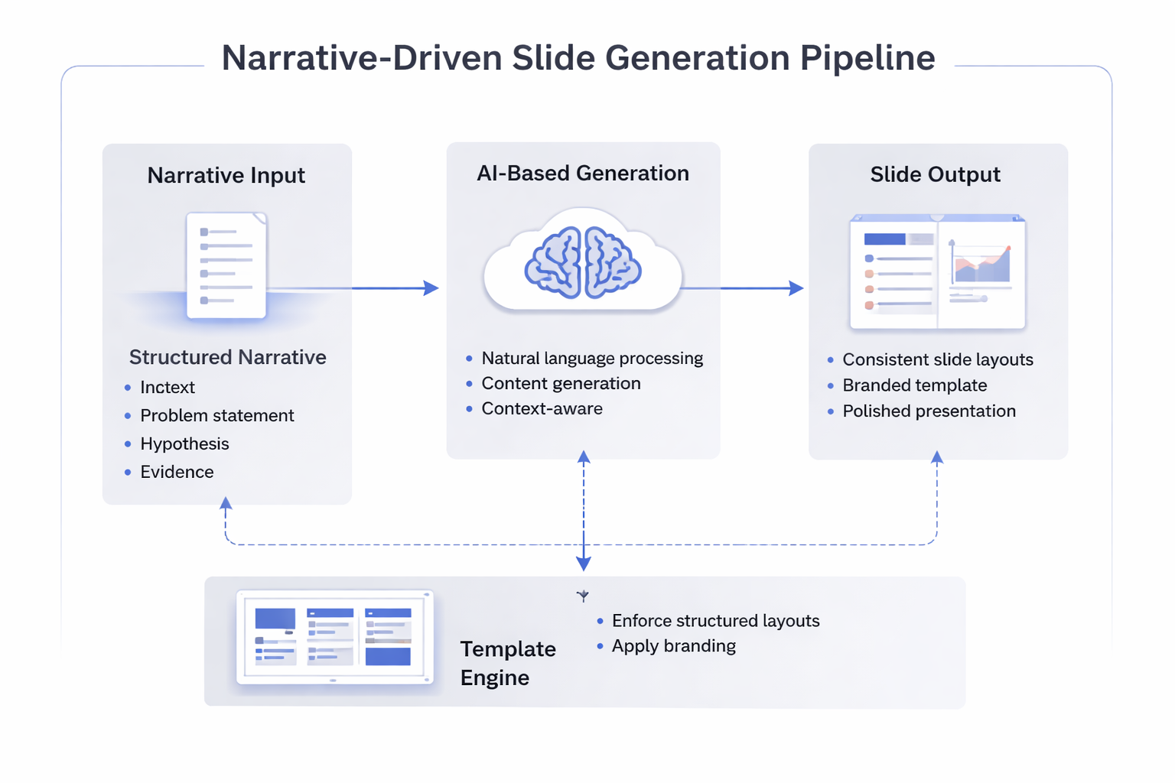
Architecture: narrative-driven slide generation pipeline
Narrative arc expressed as structured input
AI generates constrained slide content
Template layouts enforce spatial discipline

Slide 6
The mechanics are now proven, but image handling and modality growth remain
Template conversion from POTX to PPTX works locally
IBM placeholder mappings are now reliable
Picture insertion requires controlled image sizing
The next step is to expand modality coverage carefully

Slide 7
The generator can now evolve independently of the visual theme
Narrative structure is no longer tied directly to IBM layout names
The same modalities could later map to Microsoft-themed layouts
Claude can generate content without needing PowerPoint awareness

Slide 8
The next phase is to formalise schema and extend supported slide types
Add evidence and results modality
Add options considered modality
Define a proper JSON or YAML schema
Introduce validation for text density and image sizing

